Slide 1


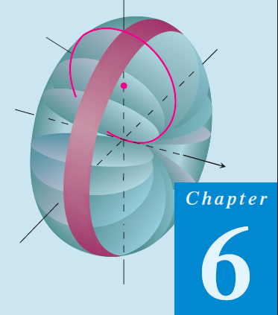
Thomas Calculus 11th
11
Integration Applications
Samuel Lukas

Slide 2
Agenda
Area Between Curves
Differential Equation
Art Length
Area of a surface of revolution
Volumes by Slicing
Revolution: The Disk Method
Revolution: The Washer Method
Volumes by Cylindrical Shells

Slide 3
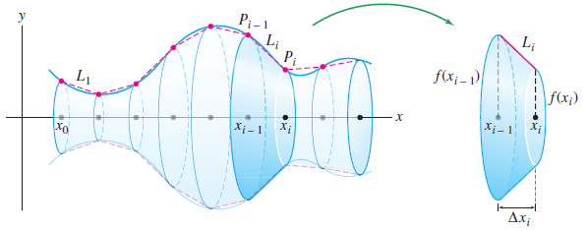




Area of a Surface of Revolution
Calculate the surface area of a sphere of radius R.

Slide 4
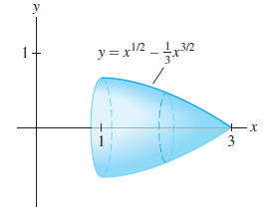




Slide 5
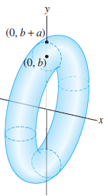
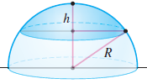


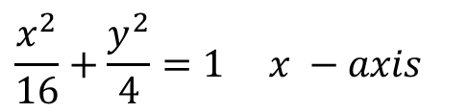
Exercises 1
Find the are of the surface generated by revolving the given arc about the x-axis
01
$${8y^{2}=x}^{2}\left(1−x^{2}\right), loop$$
02
$$y^{2}+4x=2\ln\left(y\right), 1≤y≤3$$
$$\frac{x^{2}}{16}+\frac{y^{2}}{4}=1 x −axis$$
03
04
$$x=2\cos\left(θ\right)−\cos\left(2θ\right),y=2\sin\left(θ\right)−2\cos\left(2θ\right), 0≤θ≤π x−axis$$
05
$$x=a(θ−\sin\left(θ\right),y=a(1−\cos\left(θ\right)), x−axis$$
06
Show that the surface area of a spherical cap of height h and radius
R has surface area 2πRh.
07
Find the surface area of the torus obtained by rotating the circle x² + (y − b)² = r²

Slide 6

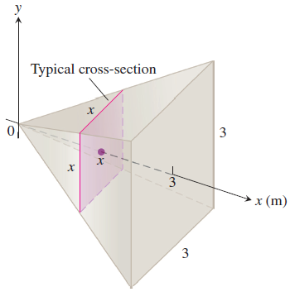


Volumes by Slicing

Slide 7

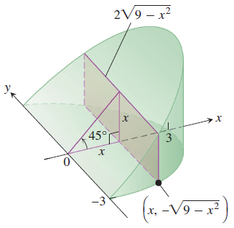





Slide 8


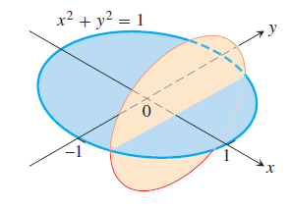
Exercises 2

Slide 9
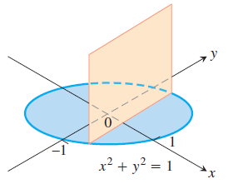
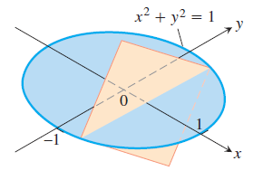
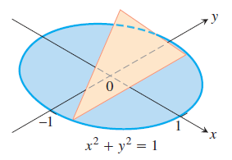


Slide 10
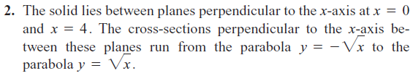
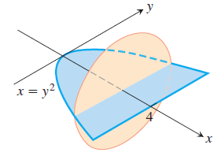
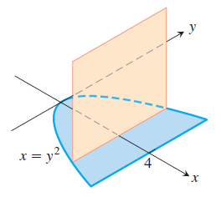

Slide 11
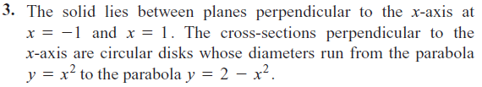

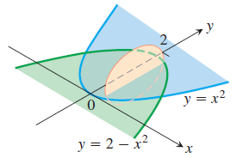
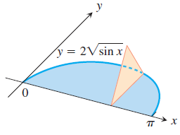

Slide 12

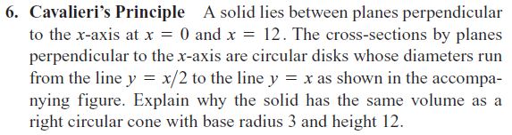
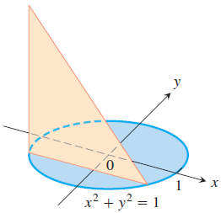
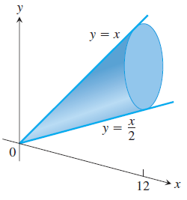

Slide 13
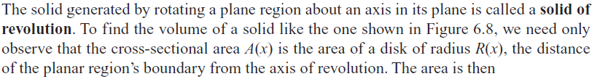

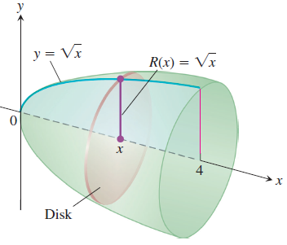

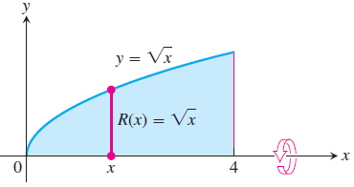

Revolution: The Disk Method

Slide 14
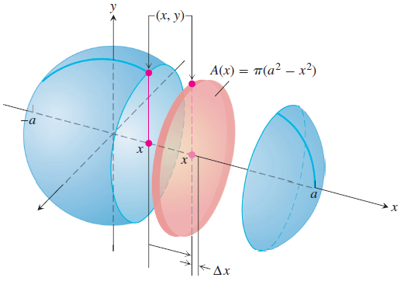





Slide 15
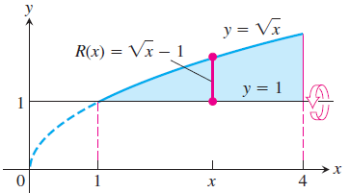
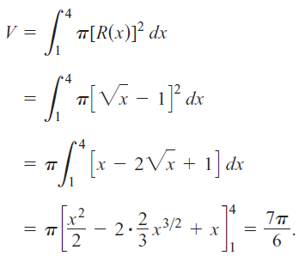
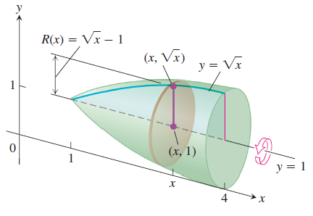

Slide 16
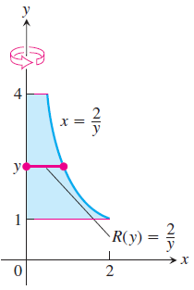
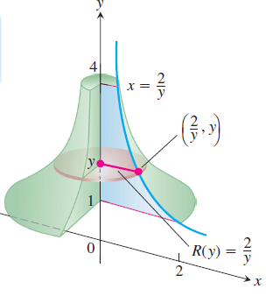




Slide 17
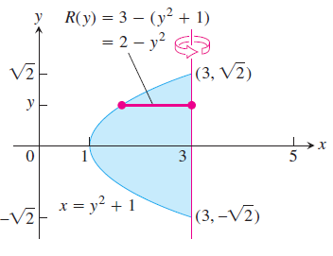
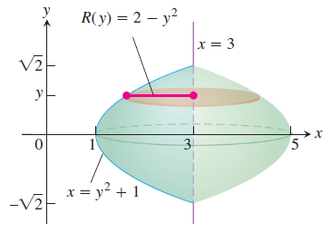





Slide 18
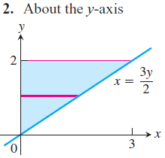
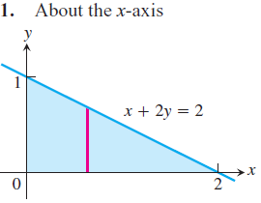
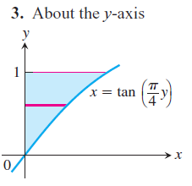
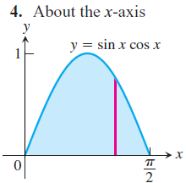
Exercises 3
In Exercises 1 – 4, find the volume of the solid generated by revolving the shaded region about the given axis.

Slide 19
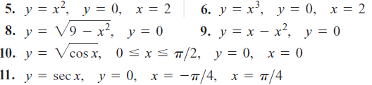
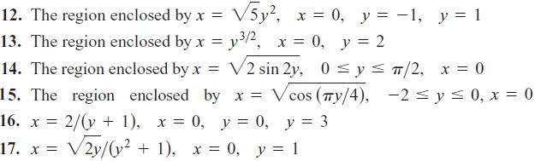
Find the volumes of the solids generated by revolving the regions bounded by the lines and curves in Exercises 5 – 11 about the x-axis
Find the volumes of the solids generated by revolving the regions bounded by the lines and curves in Exercises 12 – 17 about the y-axis.

Slide 20
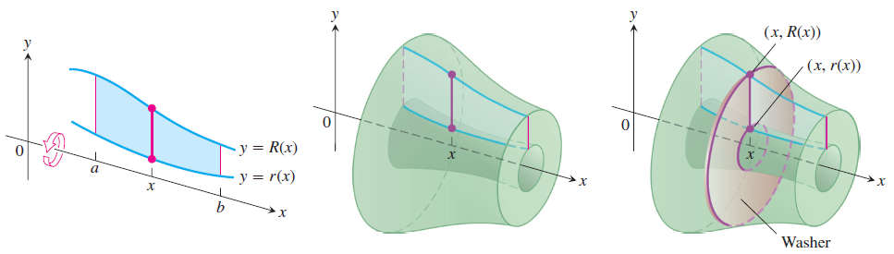

Revolution: The Washer Method
If the region we revolve to generate a solid does not border on or cross the axis of revolution, the solid has a hole in it. The cross-sections perpendicular to the axis of revolution are washers instead of disks. The dimensions of a typical washer are R(x) and r(x)

Slide 21
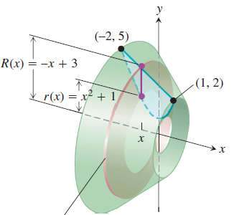
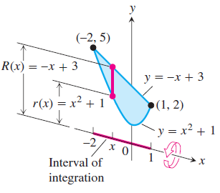



Slide 22
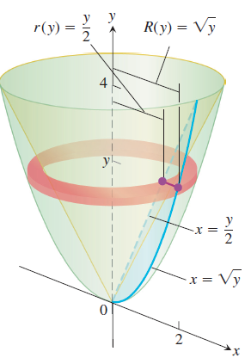
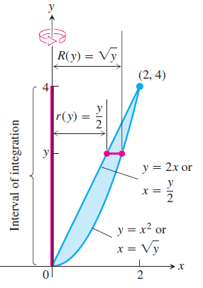




Slide 23
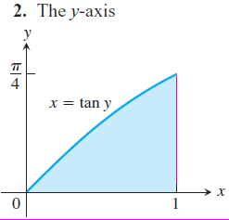
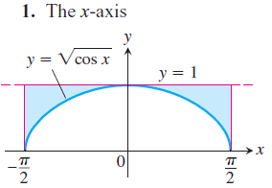
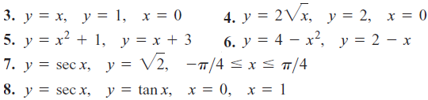
Exercises 4
Find the volumes of the solids generated by revolving the shaded regions in Exercises 1 and 2 about the indicated axes.
Find the volumes of the solids generated by revolving the regions bounded by the lines and curves in Exercises 3 – 8 about the x-axis.

Slide 24
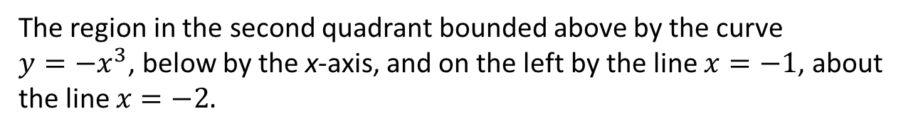
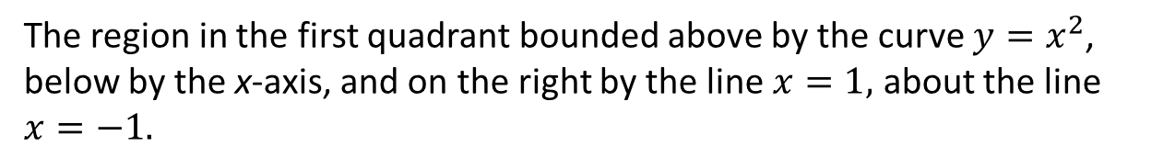
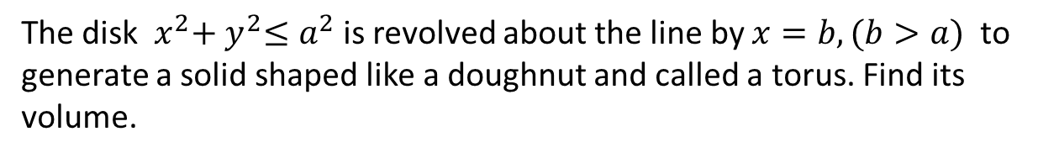
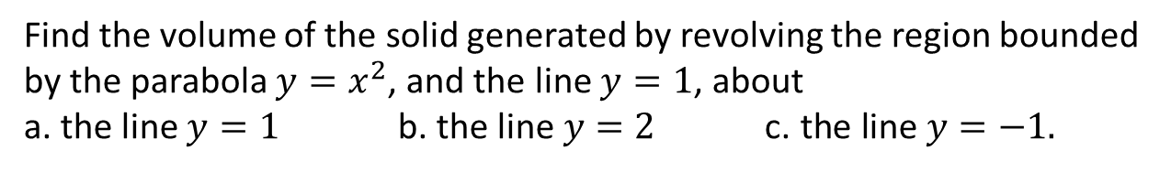
In Exercises 9 and 10, find the volume of the solid generated by revolving each region about the given axis.
09.
The region in the first quadrant bounded above by the curve $y=x^{2}$, below by the x-axis, and on the right by the line $x=1,$ about the line $x=−1.$
10.
The region in the second quadrant bounded above by the curve $y={−x}^{3}$, below by the x-axis, and on the left by the line $x=−1$, about
the line $x=−2.$
11.
Find the volume of the solid generated by revolving the region bounded by the parabola $y=x^{2}$, and the line $y=1$, about
a. the line $y=1 \text{b}\text{. }\text{the} \text{line} y=2 \text{c}\text{. }\text{the} \text{line} y=−1.$
12.
The disk${ x}^{2}{+ y}^{2}≤a^{2}$ is revolved about the line by $x=b, (b>a)$ to generate a solid shaped like a doughnut and called a torus. Find its volume.

Slide 25




Volumes by Cylindrical Shells

Slide 26






Slide 27





Slide 28






Exercises 5
In Exercises 1–6, use the shell method to find the volumes of the solids generated by revolving the shaded region about the indicated axis.

Slide 29


7
The region shown here is to be revolved about the x-axis to generate
a solid. Which of the methods (disk, washer, shell) could you use to find the volume of the solid? How many integrals would be required in each case? Explain.
8
The region shown at left is to be revolved about the y-axis to generate a solid. Which of the methods (disk, washer, shell) could you use to find the volume of the solid? How many integrals would be required in each case? Give reasons for your answers.

Slide 30




In Exercises 9 and 10, use the shell method to find the volumes of the solids generated by revolving the shaded regions about the indicated axes.

